Slide 1
OOPS USING JAVA
Second Java Program, Constants, Data Types and Variables

Slide 2
FIRST JAVA PROGRAM-EXAMPLE 1
/*This is a simple java program*/
class Example
{
public static void main (String args[])
{
System.out.println (“This is a simple Java program”);
}
}

Slide 3
SIMPLE JAVA PROGRAM-SOME IMPORTANT POINTS
public: Access specifier. main() must be made public, since it must be called by code defined outside its class.
Static: It is required because main() is called without creating an object of its class
String args[]: An array of objects of type String class. Each object of type string contains a character string. It is used to manipulate command line argument.
Java is case sensitive.
System predefined class that refers to system.
out It is static data member of System class
println() It is a member of out object

Slide 4
SECOND JAVA PROGRAM
class add_num
{
public int add(int a, int b)
{
return a+b;
}
}
public class test
{
public static void main(String args[])
{
int a, b;
a=100;
b=23;
add_num ob = new add_num();
System.out.println(“The addition: “+ ob.add_num(a,b));
}
}

Slide 5
POINTS TO BE NOTED
Java source code can contain multiple classes, the name of the source code must be the name of the only public class of the code.
Usually public class contains the main() method, that is the starting point of program execution.
Object of a class is created using new operator.
Method of a class is accessed through an object of that class.
+ in System.out.println() method concatenate two strings.

Slide 6
JAVA IS A STRONGLY TYPED LANGUAGE
Every variable and expression has a strongly defined type.
All assignments are checked for type compatibility.
Java compiler checks all expressions and parameters to ensure that the types are compatible.

Slide 7
THE PRIMITIVE TYPES
There are exactly eight primitive data types in Java
Four of them represent whole valued signed numbers:
  byte, short, int, long
Two of them represent floating point numbers:
  float, double
One of them represents characters:
  char
And one of them represents boolean values:
  boolean

Slide 8
NUMERIC PRIMITIVE TYPES
The difference between the various numeric primitive types is their size, and therefore the values they can store:
Type
byte
short
int
long
float
double
Storage
8 bits
16 bits
32 bits
64 bits
32 bits
64 bits
Min Value
-128
-32,768
-2,147,483,648
< -9 x 10¹⁸
+/- 3.4 x 10³⁸ with 7 significant digits
+/- 1.7 x 10³⁰⁸ with 15 significant digits
Max Value
127
32,767
2,147,483,647
> 9 x 10¹⁸

Slide 9
CHARACTER PRIMITIVE TYPE
It uses unicode to represent character.
The char type is unsigned 16 bit values ranging from 0 to 65536.
ASCII still ranges from 0 to 127.
Example:
class test
{ public static void main (String args[])
{
char ch1, ch2;
ch1=88;
ch2=‘Y’;
System.out.println (“ch1 and ch2: “ + ch1+” “+ch2);
}
}
Output: ch1 and ch2: X Y

Slide 10
CHARACTER PRIMITIVE TYPE
Example:
class test
{
public static void main (String args[])
{
char ch1;
ch1= ‘X’;
Sytem.out.println (“ch contains “+ch1);
ch1++;
System.out.println (“ch1 is now “ + ch1);
}
}
Output:
ch1 contains X
ch1 is now Y

Slide 11
BOOLEANS
Size is 1 bit – two value: true and false.
This type is returned by all relational operators.
Example:
boolean b;
b= true;
System.out.println(“b is “+b);
System.out.println(“10>9 is “ +(10>9));
Output:
b is true
10>9 is true

Slide 12
LITERALS
Integer Literals
1. base 10 – 1,2,43 etc.
2. base 8 – octal values are denoted in java by a leading 0.
3. base 16 – hexadecimal values are denoted by leading 0x or 0X.
Any whole number is by default integer (32 bits).
To specify a long literal, the number should appended with
an upper- or lowercase L.

Slide 13
LITERALS
Floating point Literals
1. Standard Notation – 3.14159, 0.6667, 2.0 etc.
2. Scientific Notation – 6.022E23, 2e+100.
Floating point literals are by default of type double.
To specify a float literal, we must append an F or f to the constant.
Boolean Literals
Two values – true and false.
True is not equal 1 and false is not equal to 0.
They can be assigned to variable declared as boolean.

Slide 14
LITERALS
Character Literals:
A literal character is represented inside a pair of single quotes.
Escape sequence | Unicode Representation | Description
\’ \” \\ \r \n \f \t \b \ddd \uxxxx | \u0027 \u0022 \u005c \u000d \u000a \u000b \u0009 \u0008 | Single quote Double quote Backslash Carriage Return New line Form feed Tab Backspace Octal Character Hexadecimal Unicode character

Slide 15
LITERALS
String Literals
A sequence of characters between a pair of double quotes.
In java string must begin and end on the same line.

Slide 16
VARIABLES
Variable is a name for a location in memory.
Declaring a variable:
type identifier [=value][,identifier [=value]….];
The initialization expression must result in a value of the same or compatible type as that specified for the variable.
When a variable is not initialized, the value of that variable is undefined.

Slide 17
SCOPE AND LIFETIME OF A VARIABLE
A block begins with an opening curly brace and ends by a closing curly brace.
A block determines scope, that defines which objects are visible to other parts of your program.
Variables declared within a block localize themselves.
In case of nested block, the outer block encloses the inner block. The variables declared in the outer block is visible to the inner block but the reverse is not true.
A variable will not hold it’s value once it has gone out of it’s scope.
In an inner block, it is not possible to declare a variable of the same name as in outer block.

Slide 18
SCOPE AND LIFETIME OF A VARIABLE
Example:
public static void main( String args[])
{
int x =10;
if ( x == 10)
{
int y =20;
System.out.println(“x and y: “ +x +” “+y);
x= y * 2;
}
y= 100; //Error
System.out.println (“x is “+x);
}

Slide 19
OOPS USING JAVA
Type Conversion and Casting
And Introduction to Class

Slide 20
AUTOMATIC TYPE CONVERSION
When one type of data is assigned to another type of variable, an automatic type conversion will take place if:
1. Two types are compatible.
2. The destination type is larger than the source type.
It is known as widening conversion.
The numeric types, including integer and floating point types are compatible.
Numeric types are not compatible with char or boolean.
Char and boolean are not compatible with each other.

Slide 21
AUTOMATIC TYPE CONVERSION
short’s variable = byte’s variable
int’s variable = byte’s variable
byte’s variable = int’s variable
float’s variable = int’s variable
int’s variable = float’s variable
double’s variable = float’s variable
float’s variable = double’s variable
char’s variable = any other variable
int’s variable = char’s variable
short’s variable = char’s variable
boolean variable = any other variable
Any other variable = boolean variable
ok
ok
Error
ok
Error
ok
Error
Error
ok
Error
Error
Error

Slide 22
CASTING TYPE
Problem: assigning int value to a byte type variable.
This type of conversion is known as narrowing conversion.
A cast is simply an explicit type conversion : (target_type) value
Example:
int a;
byte b;
….
b = (byte) a;
Contains the remainder of an integer division by byte’s range.

Slide 23
CASTING TYPE
class test
{
public static void main(String args[])
{
byte b;
int i = 257;
double d = 323.142;
b=(byte)i;
System.out.println (“Conversion of int to byte: ” + i +” “+ b);
i = (int)d;
System.out.println(“Conversion of double to int: “ +d+” “+i);
b=(byte)d;
System.out.println(“Conversion of double to byte: “ +d+” “+b);
}
}

Slide 24
CASTING TYPE
Output:
Conversion of int to byte: 257 1
Conversion of double to int: 323.142 323
Conversion of double to byte: 323.142 67
Note:
When assigning a fractional number’s to a whole number’s variable, fractional part is truncated.
If the value of the whole number part is too large to fit into the target integer type, then that value will be reduced modulo the targest type’s range.

Slide 25
AUTOMATIC TYPE PROMOTION IN EXPRESSION
Takes place in expression.
Rules:
1. All byte and short values are promoted to int.
2. If one operand is long, the whole expression is promoted to long.
3.If one operand is float, the entire expression is promoted to float.
4. If one operand is double, the entire expression is promoted to double.

Slide 26
AUTOMATIC TYPE PROMOTION-EXAMPLE
byte b =42;
char c=‘a’;
short s=1024;
int i=50000;
float f=5.67f;
double d=.1234;
double result = (f * b) + (i / c) – (d * s);
(f * b) is promoted to float.
(i / c) is promoted to int.
(d *s ) is promoted to double.
float + int – double = float – double = double

Slide 27
AUTOMATIC TYPE CONVERSION-EXAMPLE
byte a =40, b= 50, c =100;
int d = a * b /c;
2. byte b =50;
b = b * 2; //Error
3. byte b =50;
b = (byte) b * 2;

Slide 28
AN EXAMPLE OF OBJECT ORIENTED PROGRAMMING
Colored points on the screen
What data goes into making one?
  Coordinates
  Color
What should a point be able to do?
  Move itself
  Report its position

Slide 29
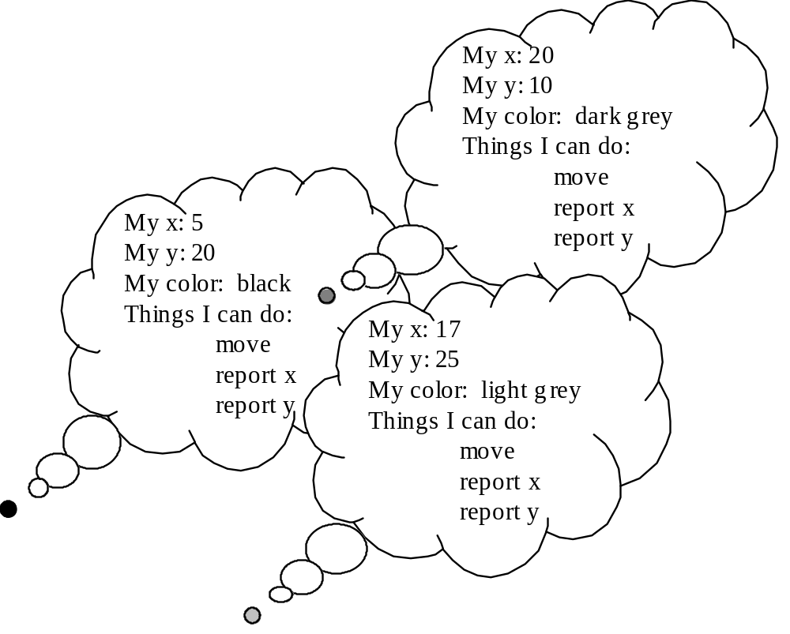

Slide 30
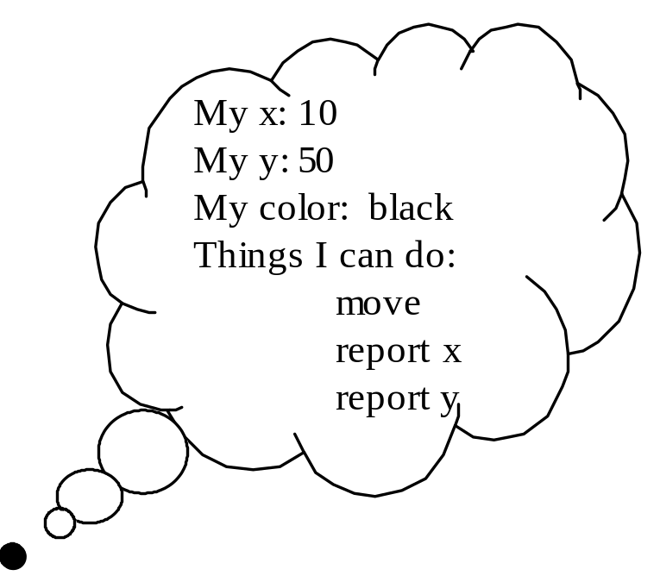
JAVA TERMINOLOGY
Each point is an object
Each includes three fields
Each has three methods
Each is an instance of the same class

Slide 31
OBJECT-ORIENTED STYLE
Solve problems using objects: little bundles of data that know how to do things to themselves
Not the computer knows how to move the point, but rather the point knows how to move itself
Object-oriented languages make this way of thinking and programming easier

Slide 32
class Point {
int xCoord;
int yCoord;
Point() {
xCoord = 0;
yCoord = 0;
}
int currentX() {
return xCoord;
}
int currentY() {
return yCoord;
}
void move (int newXCoord, int newYCoord) {
xCoord = newXCoord;
yCoord = newYCoord;
}
}

Slide 33
THE GENERAL FORM OF A CLASS
A class is defined by specifying the data and the code that operate on the data.
The general form:
class classname{
type instance-variable1;
type instance-variable2;
…………
type methodname1( parameter-list)
{
// body of the method
}
type methodname2( parameter-list)
{
//body of the method
}
……………………
}

Slide 34
CLASS AND OBJECT
A class defines a new data type. This new data type is used to create objects of that type.
A class is a template for an object and an object is an instance of a class.

Slide 35
CREATING OBJECTS
Obtaining objects of a class is two steps process:
1. Declare a variable of the class type.
2. Acquire an actual, physical copy of the object and assign it to that variable.
To allocate a physical memory new() is used. It dynamically allocates memory for an object and returns a reference to it.
In Java, all class objects must be dynamically allocated.

Slide 36
A SIMPLE EXAMPLE
class Box
{
double width;
double height;
double depth;
}
class BoxDemo
{
public static void main( String args[])
{
Box mybox, mybox1;
mybox = new Box();
mybox1 = new Box();
mybox.width=10;
mybox.height = 20;
mybox. depth = 15;
mybox1.width = 10;
mybox1.height = 25;
mybox1.depth=5;
}
}

Slide 37
A SIMPLE EXAMPLE- SOME POINTS
Members are linked to an object using dot (.) operator.
Each object contains its own copy of each instance variables defined by the class.
The java compiler automatically puts each class into it’s own .class file.
- For this example, two .class files:
1. Box.class
2. BoxDemo.class

Slide 38
A SIMPLE EXAMPLE- SOME POINTS
new() is used to dynamically allocate memory for an object.

Slide 39
A CLOSER LOOK AT NEW
Box mybox;
mybox = new Box();
Box b1 = new Box();
Box b2 = b1;
null
mybox
Width
Height
mybox
Call to the default constructor defined by the compiler. It initializes the instance variables to 0.
Depth
b1
Width
b2
Height
Depth

Slide 40
REFERENCES
An reference variable holds the memory address.
It is similar to the pointer.
Key difference- cannot manipulate as pointer– It point any arbitrary memory location or it cannot be manipulate like an integer.

Slide 41
THE NULL REFERENCE
An object reference variable that does not currently point to an object is called a null reference
The reserved word null can be used to explicitly set a null reference:
name = null;
An object reference variable declared at the class level (an instance variable) is automatically initialized to null
The programmer must carefully ensure that an object reference variable refers to a valid object before it is used

Slide 42
INSTANCE VARIABLES
Default initialization
  If the variable is within a method, Java does NOT initialize it.
  If the variable is within a class, Java initializes it as follows:
    Numeric instance variables initialized to 0
    Logical instance variables initialized to false
    Object instance variables initialized to null
Notes:
Each instance variable is defined without specifying an initial value. Therefore, whenever a new ColoredRectangle object is to be constructed, Java first initializes the new instance variables to default values. By default, numeric instance variables are initialized to 0, boolean instance variables are initialized to false, and reference-type instance variables are initialized to null.
Thus, every time a new ColoredRectangle object is to undergo construction, new width, height, x, y, window, and color instance variables are created and default initialized for the new object. The numeric attributes width, height, x, and y are initialized to zero and the class-type attributes window and color are initialized to null.
The instance variable definitions specify each of the variable to be private. This modifier indicates that direct access to the instance variables is limited to the class itself. Thus, class ColoredRectangle practices information hiding by encapsulating its attributes.
Defining instance variables to be private is a standard practice. When attributes are private, other classes are forced to use the class’s interface methods to manipulate its attributes. Those interface methods normally are programmed to ensure that the requested manipulations are valid. Because the initial definition of class ColoredRectangle does not provide any methods to give access to the attributes, once a ColoredRectangle is constructed it is immutable. In Section , we introduce several ColoredRectangle methods for accessing and modifying the attributes of a ColoredRectangle object.

